Slide 1
4. Data Transformation

Slide 2
Adstocking
What?
Advertising adstock
It is constructed to represent the ‘stock’ of present and past advertising efforts
Captures the prolonged or lagged effect of advertising (advertising memory) on consumer purchasing behavior
Initial advertising
Adstocked advertising (or advertising memory)
Popularity
Used in marketing mix models
Creating advertising & promotional refined variables
Cited in several marketing science journals

Slide 3
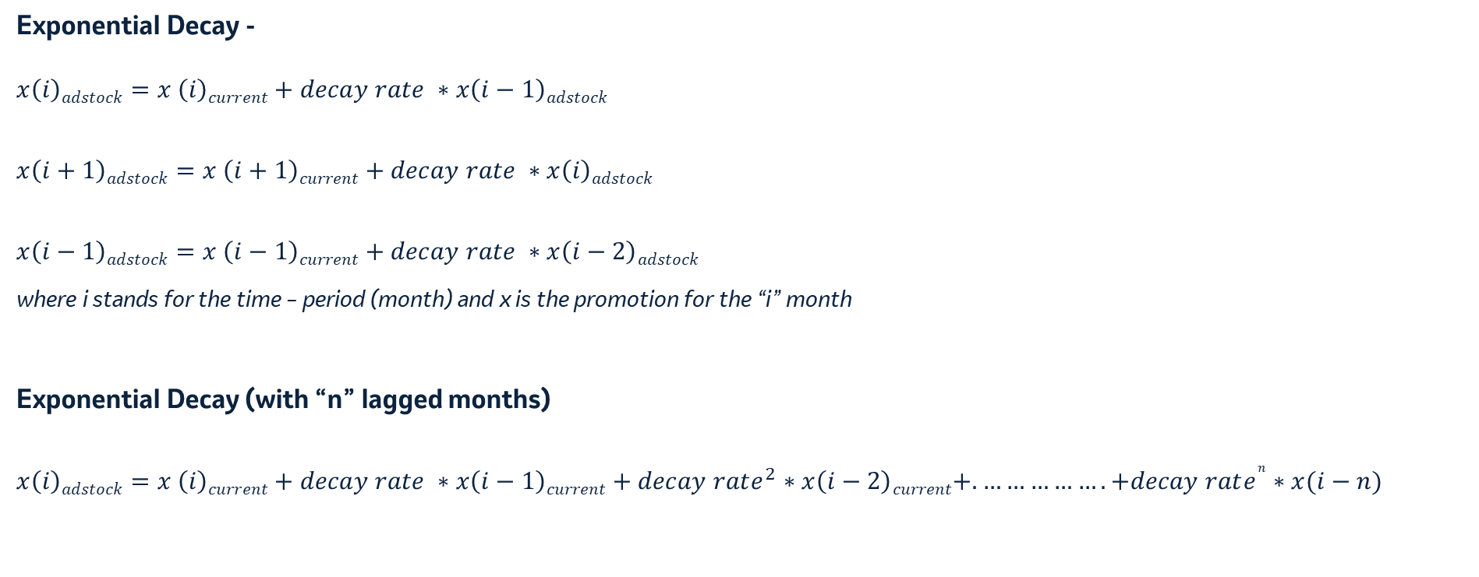
Decay forms
Exponential Decay -
$$x\left(i\right)adstock=x \left(i\right)current+decay rate ∗x\left(i−1\right)adstock$$
$$x\left(i+1\right)adstock=x \left(i+1\right)current+decay rate ∗x\left(i\right)adstock$$
$$x\left(i−1\right)adstock=x \left(i−1\right)current+decay rate ∗x\left(i−2\right)adstock$$
where i stands for the time – period (month) and x is the promotion for the “i” month
Exponential Decay (with “n” lagged months)
$$x\left(i\right)adstock=x \left(i\right)current+decay rate ∗x\left(i−1\right)current+decay rate^{2}∗x\left(i−2\right)current+.…………….+decay rate^{n}∗x(i−n)$$

Slide 4
Lagged variables
Lagged variables are used to cater for the previous promotions/sales effect on the current month.
Advantages-
Incorporating time dependencies – capture the influence of past values on the current state
Simplicity – these can relatively be straightforward to implement in the regression models
Improved model fit – it improves the model fit by accounting for temporal dependencies
Disadvantages
Overfitting – use of too many lagged variables can lead to overfitting – resulting in less interpretable and less generalized model
Data availability – historical data for lagged may be not be readily available
Loss of interpretability – while lagged variables can improve the model fit, they often come at the cost of interpretability in the real-world scenario

Slide 5
Lagged variables, Decay Factor and Half life
Month | Doses | Lagged Doses
Jan’22 | 2,677 | -
Feb’22 | 2,126 | 2,677
Mar’22 | 2,613 | 2,126
Apr’22 | 2,792 | 2,613
May’22 | 2,341 | 2,792
June’22 | 1,470 | 2,341
July’22 | 1,178 | 1,470
Aug’22 | 1,752 | 1,178
Sept’22 | 2,470 | 1,752
Oct’22 | 2,289 | 2,470
Nov’22 | 1,904 | 2,289
Dec’22 | 1,682 | 1,904
Decay Rate | Monthly Half – Life*
0.1 | 0.3
0.2 | 0.43
0.3 | 0.58
0.4 | 0.76
0.5 | 1
0.6 | 1.36
0.7 | 1.94
0.75 | 2.41
0.8 | 3.1
0.85 | 4.27
0.9 | 6.58
*Half – Life = ln(0.5)/ln(decay factor)

Slide 6
Exponential Decay and ‘N’ months decay
Zip cd | Yearmo | # Engs (x_{i}) | ‘2’ Month lag | Formula | Exponential Decay (x_{i} adstocked) | Formula
 |  |  | 0.5 |  | 0.5
1040 | Jan’22 | 2 | 2.0 | =x_{i} | 2.0 | =x_{i}
1040 | Feb’22 | 2 | 3.0 | =x_{i}+x_{i-1}*0.5 | 3.0 | =x_{i}+x_{i-1 adstock}*0.5
1040 | Mar’22 | 3 | 4.5 | =x_{i}+x_{i-1}*0.5+x_{i-2}*0.5*0.5 | 4.5 | =x_{i}+x_{i-1 adstock}*0.5
1040 | Apr’22 | 2 | 4.0 | =x_{i}+x_{i-1}*0.5+x_{i-2}*0.5*0.5 | 4.3 | =x_{i}+x_{i-1 adstock}*0.5
1040 | May’22 | 3 | 4.8 | =x_{i}+x_{i-1}*0.5+x_{i-2}*0.5*0.5 | 5.1 | =x_{i}+x_{i-1 adstock}*0.5
1040 | June’22 | 7 | 9.0 | =x_{i}+x_{i-1}*0.5+x_{i-2}*0.5*0.5 | 9.6 | =x_{i}+x_{i-1 adstock}*0.5
1040 | July’22 | 5 | 9.3 | =x_{i}+x_{i-1}*0.5+x_{i-2}*0.5*0.5 | 9.8 | =x_{i}+x_{i-1 adstock}*0.5
1040 | Aug’22 | 1 | 5.3 | =x_{i}+x_{i-1}*0.5+x_{i-2}*0.5*0.5 | 5.9 | =x_{i}+x_{i-1 adstock}*0.5
1040 | Sept’22 | 3 | 4.8 | =x_{i}+x_{i-1}*0.5+x_{i-2}*0.5*0.5 | 5.9 | =x_{i}+x_{i-1 adstock}*0.5

Slide 7
Decay rates ranges for promotional channels
Channels | Decay Rate Range | Monthly Half Life
Sales force | 0.4 – 0.6 | 0.76 - 1.36
Samples | 0.3 – 0.5 | 0.58 - 1
Vouchers | 0.2 - 0.5 | 0.43 - 1
Non- Personal Promotions (alerts, banners, email, edetail) | 0.3 – 0.6 | 0.58 - 1.36
TV | 0.4 – 0.7 | 0.76 - 1.94
Social | 0.3 – 0.7 | 0.58 - 1.94
Online Video | 0.4 – 0.8 | 0.76 - 3.1
Paid Search | 0.3 – 0.7 | 0.58 - 1.94
Radio | 0.3 – 0.8 | 0.58 - 3.1
Organic Search | 0.4 – 0.6 | 0.76 - 1.36

Slide 8
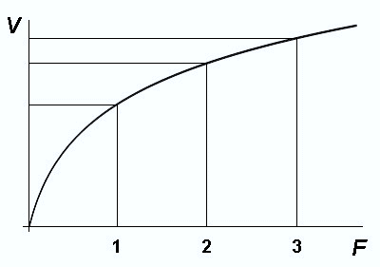

Variable Transformation (Diminishing Curves)
Law of diminishing returns
The law of diminishing returns states that in all productive processes, adding more of one factor of production, while holding all others constant, will, at some point, yield lower incremental per-unit return
Assisting marketing channels
There are multiple channels of promotion – no single channel is completely responsible for entire sales
Example: Beyond a point, a particular channel promotion cannot make any difference to brand sales as other channels too have an impact on brand sales

Slide 9
Variable Transformation (Diminishing Curves)
Linear
Non Dimishing Return
Simple, can calculate historical avg ROI but not “optimal”
20
50
Sometimes seen, not useful
15
40
10
30
5
20
10
0
0
2
4
6
8
10
12
14
16
18
20
22
24
26
28
30
0
0
2
4
6
8
10
12
14
16
18
20
22
24
26
28
30
Diminishing Return
Stepwise
Possibly realistic, but hard to model or to act on
Negative exponential, Logarithmic, Power (<1)
15
15
10
10
5
5
0
0
2
4
6
8
10
12
14
16
18
20
22
24
26
28
30
0
0
2
4
6
8
10
12
14
16
18
20
22
24
26
28
30
S Shaped Return
Piecewise Linear
Typically only when data is limited . . .
Accounts for threshold effect
15
100
10
80
60
5
40
20
0
0
2
4
6
8
10
12
14
16
18
20
22
24
26
28
30
0
0
2
4
6
8
10
12
14
16
18
20
22
24
26
28
30
In all models: X axis: Effort Y axis: Return

Slide 10
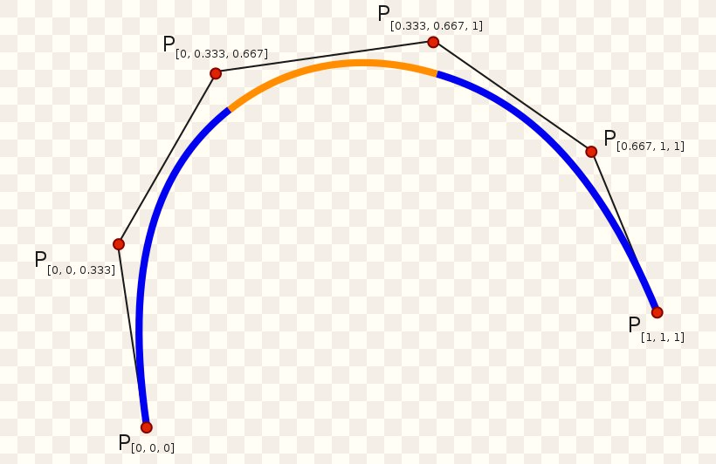

Graphical Shapes
Equations –
Linear - $y=ax+c$
Spline curve

Slide 11

Graphical Shapes
Equations –
Log Curve - $y=a∗\ln\left(1+x\right)$
Negative Exp - $y=a∗(1−exp⁡(−c∗x)$
S Curve - $1/(1+\exp\left(−x\right))$

Slide 12

Graphical Shapes
Equations –
Polynomial (degree 2) - $ax+bx^{2}$
Polynomial (degree 3) - $ax+bx^{2}+cx^{3}$
Square - $y=ax^2$

Slide 13

Root Transformation
Equations –
Power Curve - $y=ax^{b}$
where b varies from 0.1 to 0.9

